Slide 1


for free users in 10 Minutes or less

Slide 2




Notes:
https://www.youtube.com/channel/UC35ZpwldGw7ZJ5R-2sLijzw

Slide 3
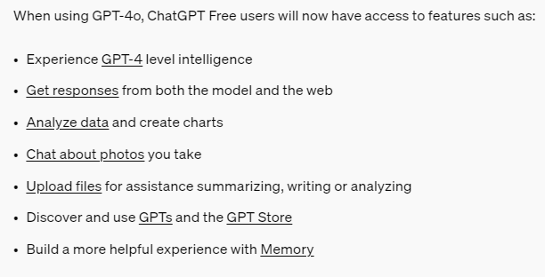
Notes:
https://openai.com/index/gpt-4o-and-more-tools-to-chatgpt-free/

Slide 4
Gpt 4 level intelligence

Slide 5
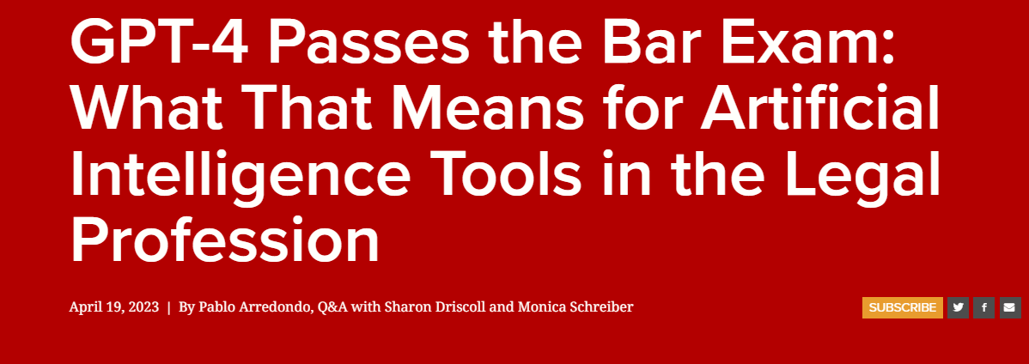
Notes:
https://law.stanford.edu/2023/04/19/gpt-4-passes-the-bar-exam-what-that-means-for-artificial-intelligence-tools-in-the-legal-industry/

Slide 6
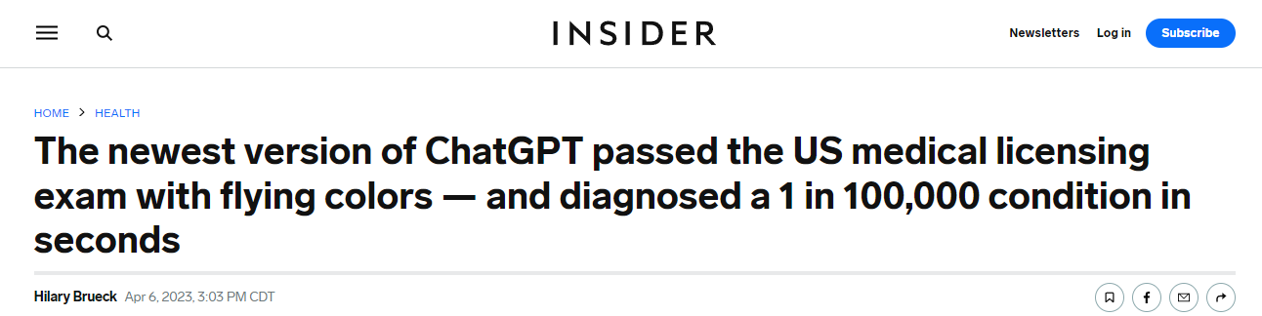
Notes:
https://www.insider.com/chatgpt-passes-medical-exam-diagnoses-rare-condition-2023-4

Slide 7
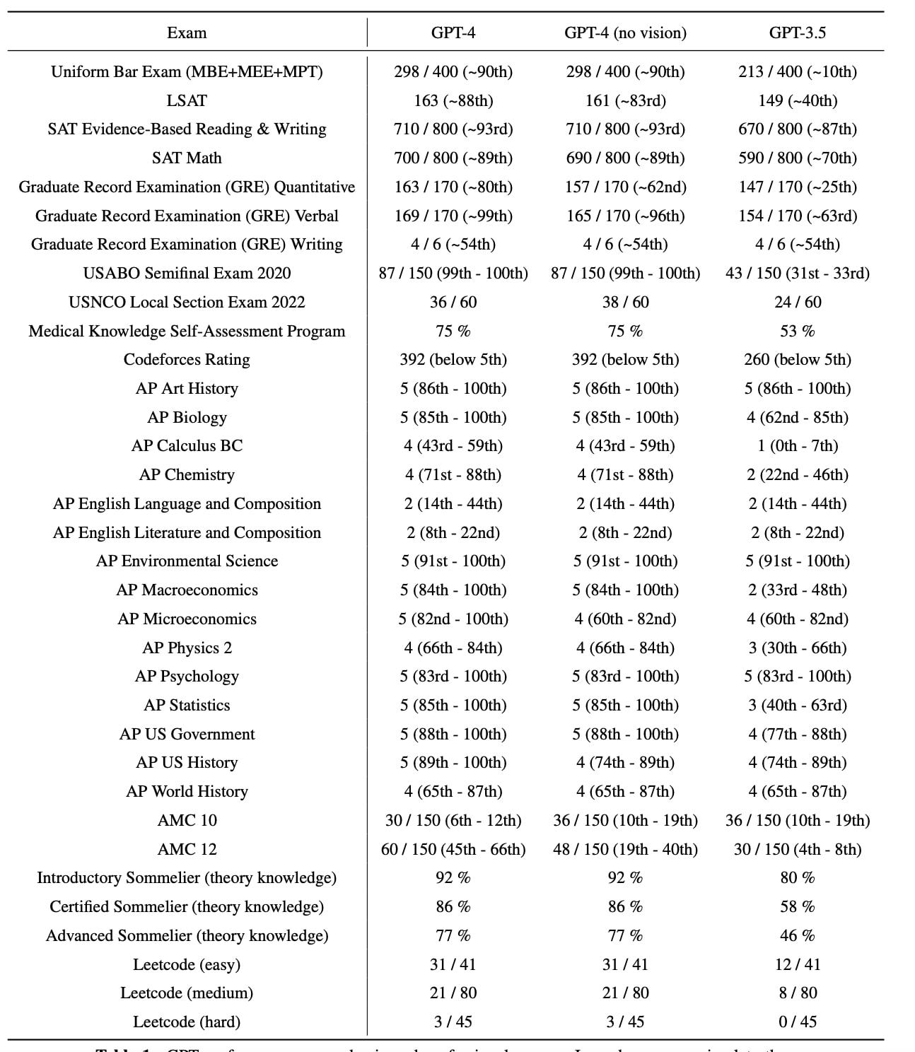
Notes:
https://www.nextbigfuture.com/2023/03/gpt-4-scores-in-top-10-for-legal-bar-exam.html

Slide 8
Responses from the web
Notes:
What is the weather like in Houston today?

Slide 9
Analyzing data
Notes:
Give me a summary of this data and two visualizations.

Slide 10
Chat About Photos
Notes:
What is this and how do I make it?

Slide 11
Upload files for summarizing
Notes:
Give me one paragraph on this story and 3 bullet points that tell me what it is about.

Slide 12
Gpt’s and the gpt store

Slide 13
More powerful experience with memory

Slide 14


